Slide 1
HOUSING PRICE PREDICTION
Using Linear Regression (Kaggle House Prices Dataset)
Group No: 02
Maryam Khan — 2023-UAM-2268
Muneeb Ur Rahman — 2023-UAM-2228
Arslan Zafar — 2023-UAM-2225
Sadaf Javed — 2023-UAM-2234
Bushra Kanwal — 2023-UAM-2238
Afifa Shafiq — 2023-UAM-2271
Tools: Python • pandas • scikit-learn • matplotlib
Submission: GitHub Repository + Report + Presentation
MNS University of Agriculture

Slide 2
Problem Statement & Objectives
What are we solving?
Goal: predict the house sale price (SalePrice) from measurable attributes.
Approach: supervised learning (regression) using a simple, explainable baseline model.
Deliverables: runnable Python code, graphs, report, and GitHub repository.
Evaluation: compare predicted vs actual prices and compute standard regression metrics.
Group 02 • Housing Price Prediction
Presented by: Maryam Khan
1

Slide 3
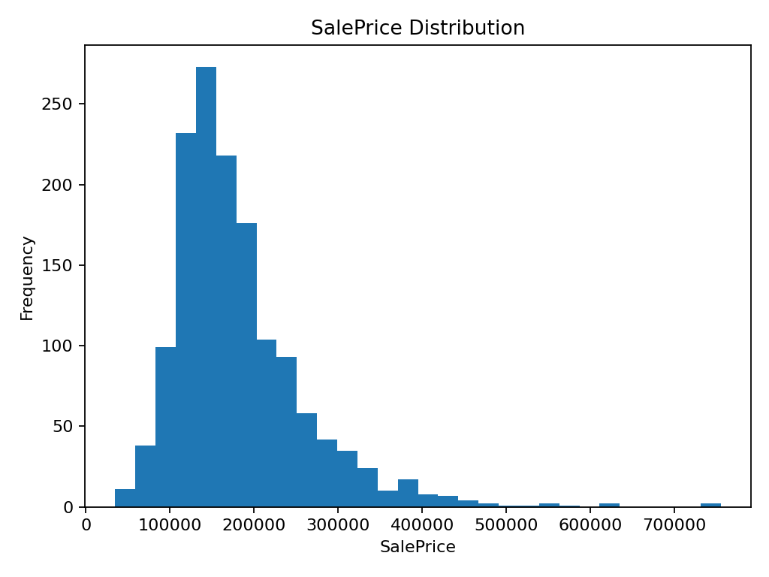
Dataset Overview
Kaggle House Prices Dataset
Source: Kaggle — House Prices: Advanced Regression Techniques
Records: 1,460 houses; Columns: 81 features + target
Target: SalePrice (house sale price in USD)
Selected columns have 0 missing values in this dataset split.
Rows
Columns
SalePrice Mean
1,460
81
180,921
SalePrice Max
SalePrice Median
755,000
163,000
SalePrice Distribution
Observation: prices are right-skewed (few expensive houses).
This motivates careful error analysis and potential log-transform in future work.
Group 02 • Housing Price Prediction
Presented by: Maryam Khan
2

Slide 4
Feature Selection
Features
Why these features?
GrLivArea — primary living area (size effect).
OverallQual — overall material/finish quality (1–10).
BedroomAbvGr — number of bedrooms.
FullBath — number of full bathrooms.
GarageCars — garage capacity.
Directly linked to price in real life (size, quality, facilities).
Numeric columns → minimal preprocessing.
Keeps the model interpretable for viva.
Strong baseline before trying advanced models.
Group 02 • Housing Price Prediction
Presented by: Muneeb Ur Rahman
3

Slide 5
Data Preparation
Training / Testing Split
Loaded train.csv using pandas.
Selected 5 numerical features and target SalePrice.
Split data into 80% training and 20% testing.
Used a fixed random_state (42) for reproducibility.
Workflow
Load Data → Select Features → Split → Train Model → Predict → Evaluate + Plot
This pipeline is simple, reproducible, and easy to demonstrate in GitHub.
Group 02 • Housing Price Prediction
Presented by: Muneeb Ur Rahman
4

Slide 6
Model Overview
Linear Regression
A supervised learning algorithm for continuous-value prediction.
Learns a linear relationship between features and SalePrice.
Easy to interpret and serves as a strong baseline model.
Why Linear Regression?
Simple training and fast execution.
Interpretability: coefficients show feature impact.
Strong for baseline and academic demonstration.
Low complexity for a clean viva explanation.
Model Equation
SalePrice = b0 + b1·GrLivArea + b2·OverallQual + b3·BedroomAbvGr + b4·FullBath + b5·GarageCars
Group 02 • Housing Price Prediction
Presented by: Arslan Zafar
5

Slide 7
Implementation
Python + scikit-learn Pipeline
Libraries: pandas, scikit-learn, matplotlib.
Read CSV → create feature matrix X and target y.
Train model using LinearRegression().
Predict on test set and visualize results.
Key Implementation Steps
1) data = pd.read_csv("train.csv")
2) X = data[[...features...]] ; y = data["SalePrice"]
3) train_test_split (80/20)
4) model.fit(X_train, y_train)
5) predictions = model.predict(X_test)
6) plot Actual vs Predicted
Group 02 • Housing Price Prediction
Presented by: Arslan Zafar
6

Slide 8
Evaluation Metrics
How do we judge performance?
RMSE: penalizes large errors more (lower is better).
MAE: average absolute error in currency units (lower is better).
R²: explained variance (closer to 1 is better).
We also use 5-fold cross-validation RMSE for stability.
Interpretation: Lower RMSE/MAE and higher R² indicate better predictive quality.
Group 02 • Housing Price Prediction
Presented by: Sadaf Javed
7

Slide 9
Performance Results
Test Set & Cross-Validation
Test Set (20%)
5-Fold Cross-Validation
RMSE: 41,832
MAE: 27,815
R²: 0.772
RMSE (mean): 40,568
RMSE (std): 6,133
Learned Coefficients (Impact Direction)
OverallQual (+) and GarageCars (+) strongly increase price; GrLivArea (+) increases price.
BedroomAbvGr shows a negative coefficient in this simple linear model due to correlations with other variables.
Group 02 • Housing Price Prediction
Presented by: Sadaf Javed
8

Slide 10
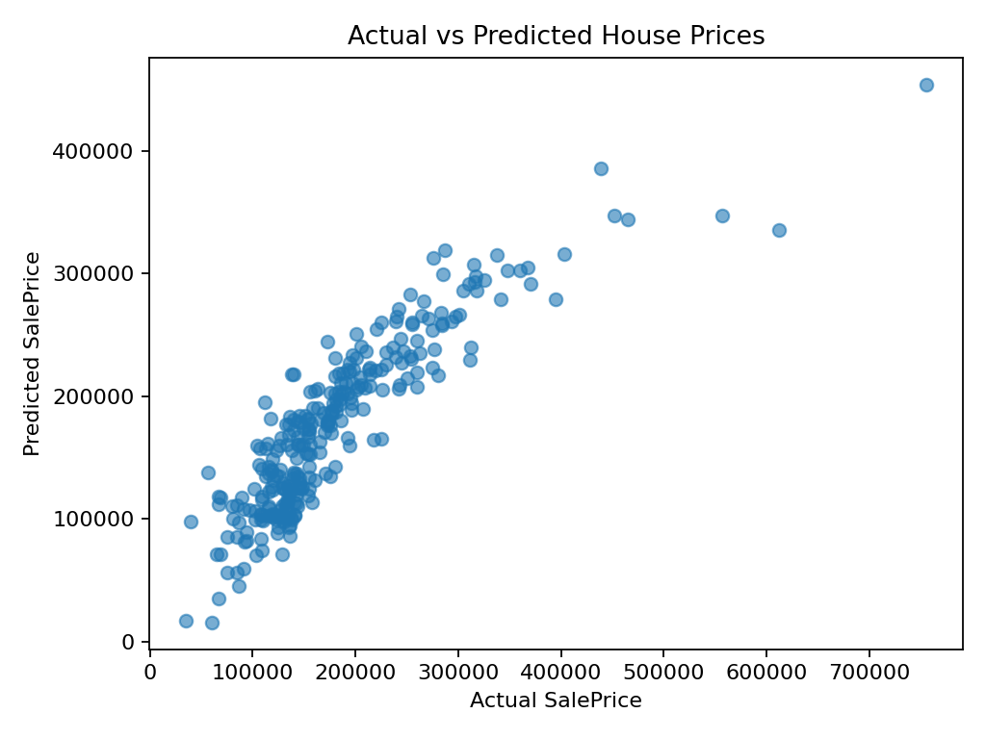
Visualization
Actual vs Predicted
Each point represents a house in the test set.
Closer to diagonal trend → better prediction.
Outliers exist at very high prices (harder to predict with a simple linear model).
Group 02 • Housing Price Prediction
Presented by: Bushra Kanwal
9

Slide 11
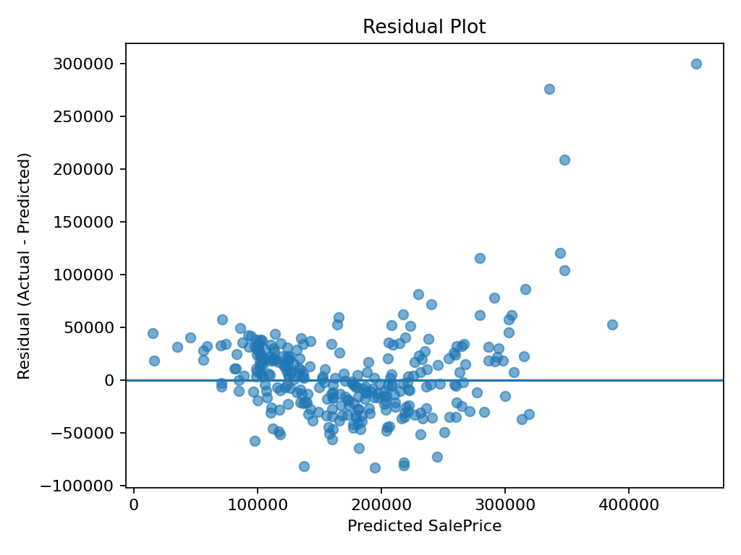
Error Analysis
Residual Plot
Residual = Actual − Predicted.
Ideal: residuals scattered randomly around zero.
Patterns or increasing spread can indicate missing variables or non-linearity.
Group 02 • Housing Price Prediction
Presented by: Bushra Kanwal
10

Slide 12
Limitations & Improvements
What can be improved?
Limitations
Improvements
Uses only 5 numeric features (missing location/condition effects).
Linear assumptions may not capture complex patterns.
Outliers and skewed prices can increase error.
Add more features (e.g., YearBuilt, Neighborhood) with proper encoding.
Try regularization (Ridge/Lasso) to reduce overfitting.
Try tree-based models (Random Forest, Gradient Boosting).
Apply log transform to SalePrice for skewness handling.
Group 02 • Housing Price Prediction
Presented by: Afifa Shafiq
11

Slide 13
Repository & Execution
How to Run + GitHub Submission
Project Structure
GitHub Submission Checklist
Housing-Price-Prediction
├─ train.py
├─ train.csv
└─ README.md
Create repository: Housing-Price-Prediction
Add train.py, train.csv, README.md
Commit and push changes (git add/commit/push)
Add report + presentation files
Share repository link in slides/report
Run:
python train.py
Group 02 • Housing Price Prediction
Presented by: Afifa Shafiq
12

Slide 14
Project Repository
Repository Includes:
Python training script (train.py)
Dataset used for model training
Project report and presentation
Documentation (README)
Ensures transparency and reproducibility of results
Allows reviewers to run and verify the project independently
GitHub Repository Link:
https://github.com/Muneebworks/Housing-Price-Prediction
Group 02 • Housing Price Prediction
Presented by: Afifa Shafiq
12

Slide 15
Thank You
Questions & Discussion

